Slide 1

Employee Attrition & Performance Prediction
A comprehensive machine learning solution for predicting employee attrition and performance ratings, featuring an interactive dashboard for HR teams to make data-driven workforce decisions.

Slide 2




Project Overview
Predict Attrition Risk
Performance Ratings
Identify employees likely to leave using Random Forest models with class imbalance handling
Forecast employee performance ratings (1-4) using Logistic Regression
Interactive Dashboard
Streamlit-powered interface for visualizations, individual predictions, and batch file uploads

Slide 3
Key Features
Data Processing
Visual Analytics
Automated data cleaning and preprocessing
EDA across departments, education, job roles
Duplicate handling and column standardization
Gender and attrition trend analysis
Prepared data subsets for analysis
Plotly-powered interactive charts
Predictive Models
Flexible Predictions
Attrition: Random Forest with imbalance handling
Individual employee form input
Batch CSV file upload support
Performance: Logistic Regression (4 rating levels)

Slide 4
Dashboard Navigation
01
02
03
Home
Analyse
Dashboard Report
Overview dashboard with filters and employee statistics at a glance
Visual EDA exploring attrition patterns by gender, department, education, and job role
Predefined analysis summary with key insights and findings
04
05
Attrition Prediction
Performance Rating
Form and file upload interface for predicting employee turnover risk
Predict employee performance ratings through form or batch upload

Slide 5





Technical Architecture
Data Layer
Employee HR datasets with cleaning via Fun.py module
Processing
Preprocessing pipelines (Att_Preprocess.pkl, PR_Preprocess.pkl)
Visualization
Seaborn,Plotly charts via Analyze.ipynb, dash.py class
ML Models
Trained models (Att_Model.pkl, PR_Model.pkl)
Interface
Streamlit app (app.py) for user interaction

Slide 6
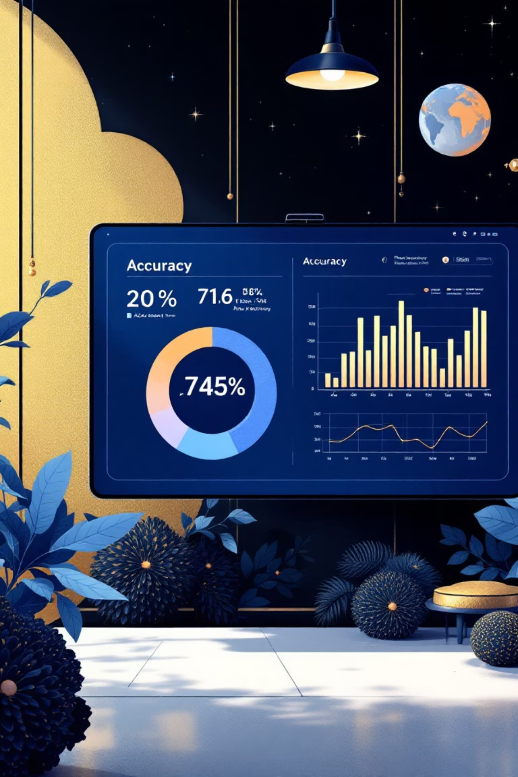
Model Performance
Attrition Prediction
Performance Rating
Algorithm: Random Forest Classifier
Algorithm: Logistic Regression
Key Feature: Class imbalance handling using SMOTE and class weights
Output: Multi-class (Ratings 3-4)
Training: Perfo_Predi.ipynb notebook
Output: Binary classification (Stay/Leave)
Features: Job satisfaction, work-life balance, years at company
Training: Att_Predi.ipynb notebook

Slide 7

Installation & Setup
Create Virtual Environment
Clone Repository
python -m venv .venvsource .venv/bin/activate# Windows: .venv\Scripts\activate
git clone https://github.com/arun8nov/Employee_Attrition.gitcd Employee_Attrition
Launch Dashboard
Install Dependencies
streamlit run app.py
pip install -r requirements.txt

Slide 8

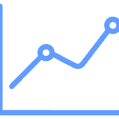




Technology Stack
Data Science
Visualization
pandas, numpy for data manipulation and analysis
matplotlib, seaborn, plotly for interactive charts
Machine Learning
Web Interface
scikit-learn, imbalanced-learn for model training
Streamlit for interactive dashboard deployment
Development
Model Storage
Jupyter notebooks for experimentation and analysis
Pickle files for serialized models and pipelines

Slide 9

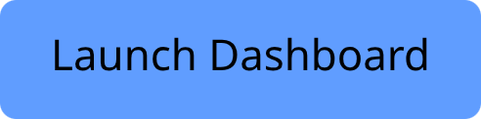


Live Dashboard
Access Now
Experience the full interactive dashboard with real-time predictions and comprehensive analytics.
Features: Upload CSV files for batch predictions, explore attrition trends, and generate performance forecasts instantly.

Slide 10

Project Impact
2
5
100%
Predictive Models
Dashboard Pages
Open Source
Comprehensive analytics and prediction interfaces
Fully accessible on GitHub for HR teams
Attrition and Performance Rating forecasting
"Developed by Arunprakash B for HR analytics and workforce management solutions. Empowering organizations to make data-driven decisions about their most valuable asset: their people."

